Slide 1
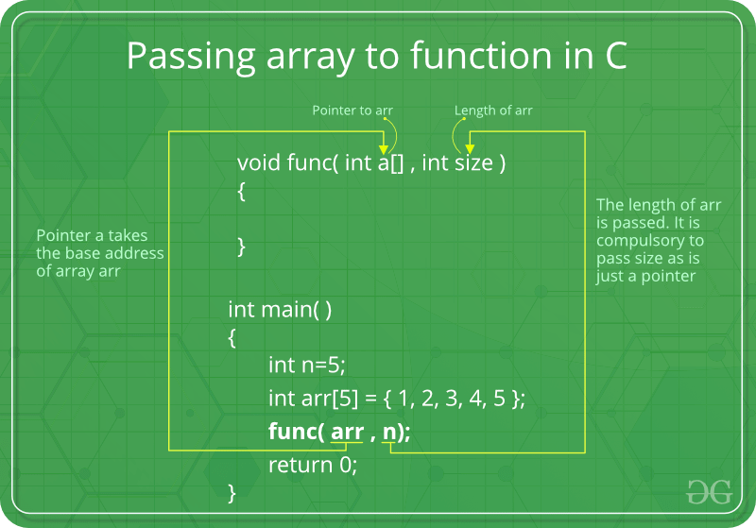
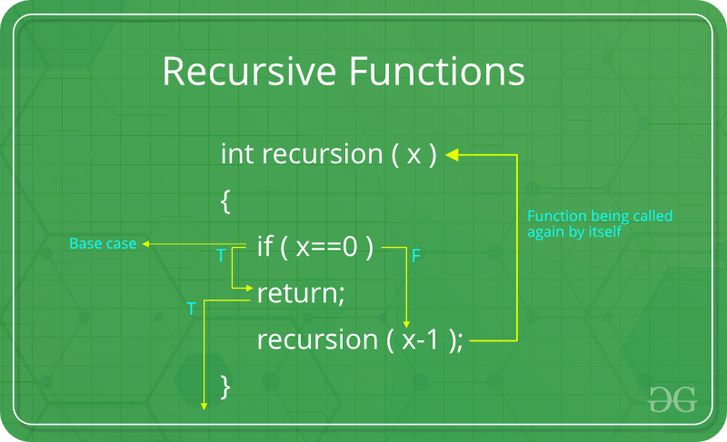

Array and Function in C/C++

Slide 2
Array in C/C++

Slide 3
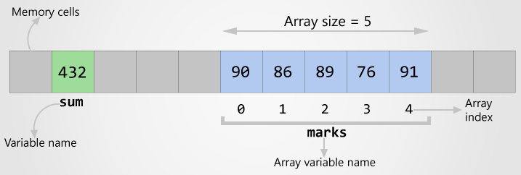
Arrays in C – Declare, initialize and access
Array is a collection - Array is a container that can hold a collection of data.
Array is finite - The collection of data in array is always finite, which is determined prior to its use.
Array is sequential - Array stores collection of data sequentially in memory.
Array contains homogeneous data - The collection of data in array must share a same data type.

Slide 4
How to declare an array?
DATA_TYPE array_name[SIZE];
DATA_TYPE is a valid C data type
array_name is name given to array
SIZE is a constant value
int marks[5];

Slide 5
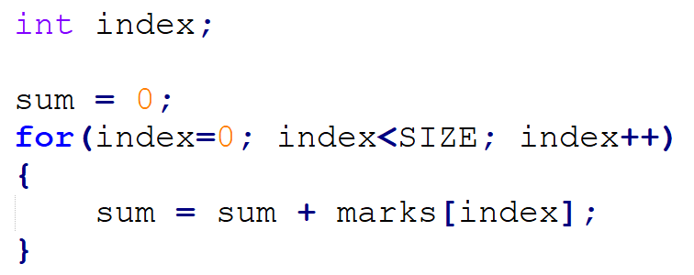
How to initialize an array
int marks[5] = {90, 86, 89, 76, 91};
int marks[] = {90, 86, 89, 76, 91};
marks[0] = 90;
marks[1] = 86;
marks[4] = 91

Slide 6
Exercise
Write a program to read and print elements of array. It is assumed that the array has 5 elements. The input is a text file, named input_array.txt. The split character in the text file is the space character.

Slide 7
Exercise Online
https://www.w3resource.com/c-programming-exercises/basic-algo/index.php
https://codeforwin.org/2016/03/functions-programming-exercises-and-solutions-in-c.html

Slide 8
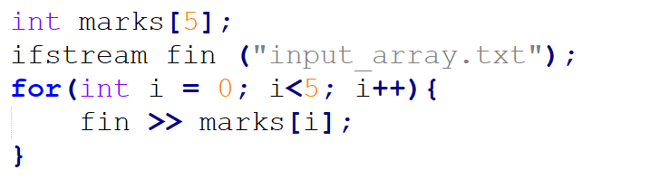
Answer

Slide 9
Exercise
Write a program to print all negative elements in an array.
Write a C program to find sum of all array elements
Write a C program to find maximum and minimum element in an array
Write a C program to find second largest element in an array.
Write a C program to count total number of even elements in an array.
Write a C program to count frequency of each element in an array.
Write a C program to print all unique elements in the array.

Slide 10
Exercise
Write a C program to copy all elements from an array to another array.
Write a C program to insert an element in an array.
Write a C program to delete an element from an array at specified position.

Slide 11
Function and Recursive in C

Slide 12
Introduction to Function
A function is a collection of statements grouped together to do some specific tasks
printf(), scanf() and main() are functions
Why functions are used?
Divide code for all tasks into separate functions.
From main(), these functions are called to execute the tasks

Slide 13
Advantages of Functions
Reusability of code. Functions once defined can be used any several times
Function allows modular design of code. Modular programming leads to better code readability, maintenance and reusability.
It is easier to write programs using functions. You can write code for separate task individually in separate function.
Code maintenance and debugging is easier. In case of errors in a function, you only need to debug that particular function instead of debugging entire program.

Slide 14
Function Declaration
return_type function_name(parameter_list);
return type: int, double, float or void
function_name: a valid C identifier
parameter_list: input data

Slide 15
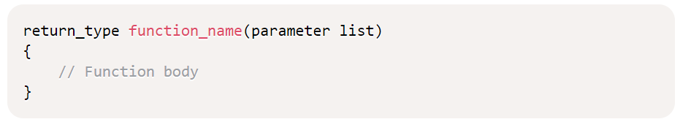
Function Definition

Slide 16
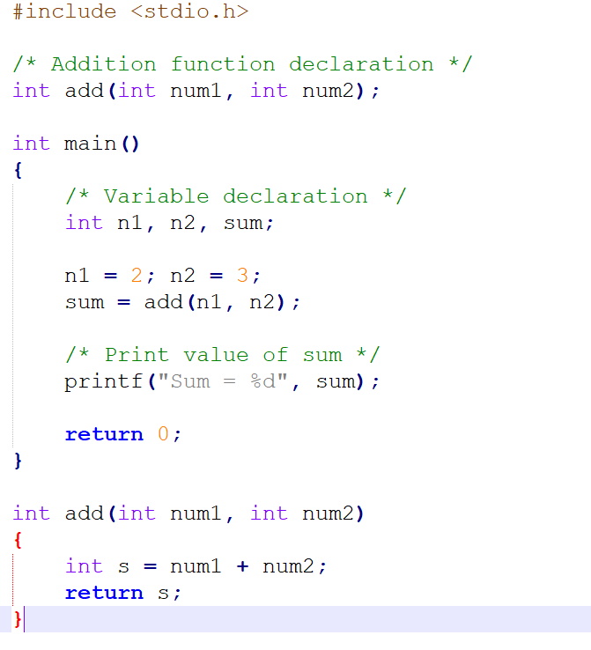
Example

Slide 17
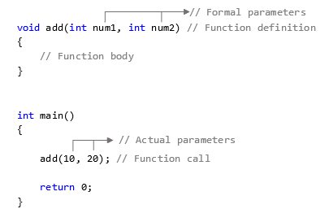
Arguments – Call by Value
Parameter value is copied and passed to formal parameter

Slide 18
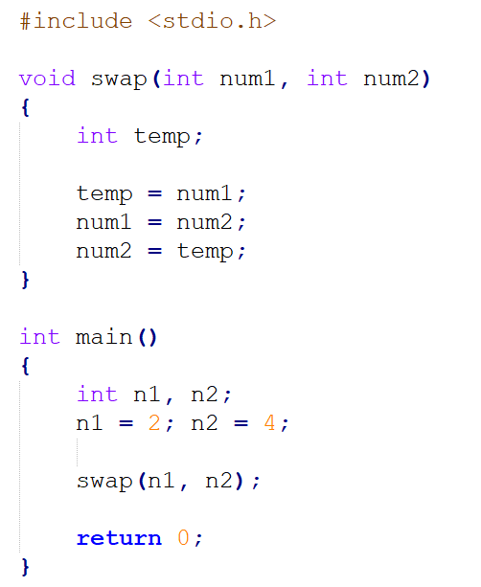
Example

Slide 19
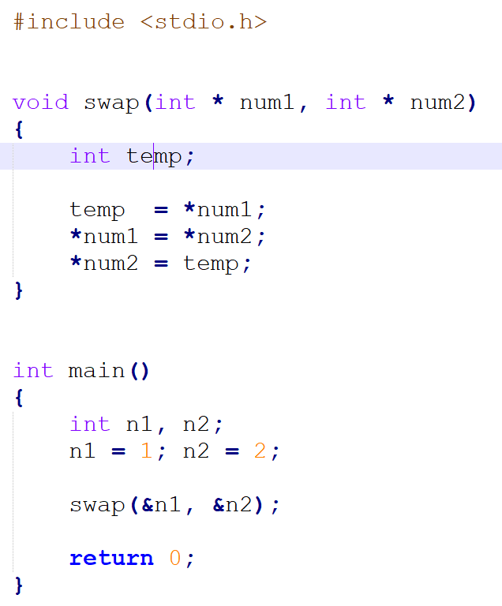
Argument – Call by Reference

Slide 20
void swap(int *num1, int* num2){
int temp = *num1;
*num1 = *num2;
*num2 = temp;
}
void main(){
int n1 = 1, n2 = 2;
swap(&n1, &n2);
return;
}

Slide 21
void swap(int *num1, int* num2){
int temp = *num1;
*num1 = *num2;
*num2 = temp;
}
void main(){
int n1 = 1, n2 = 2;
swap(&n1, &n2);
return;
}

Slide 22
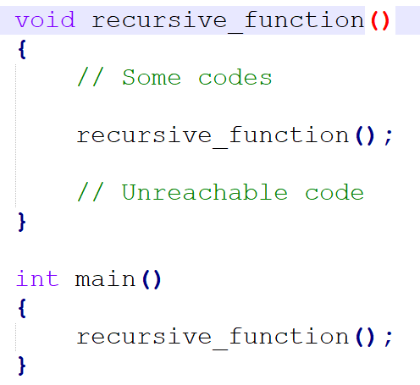
Recursion in C

Slide 23
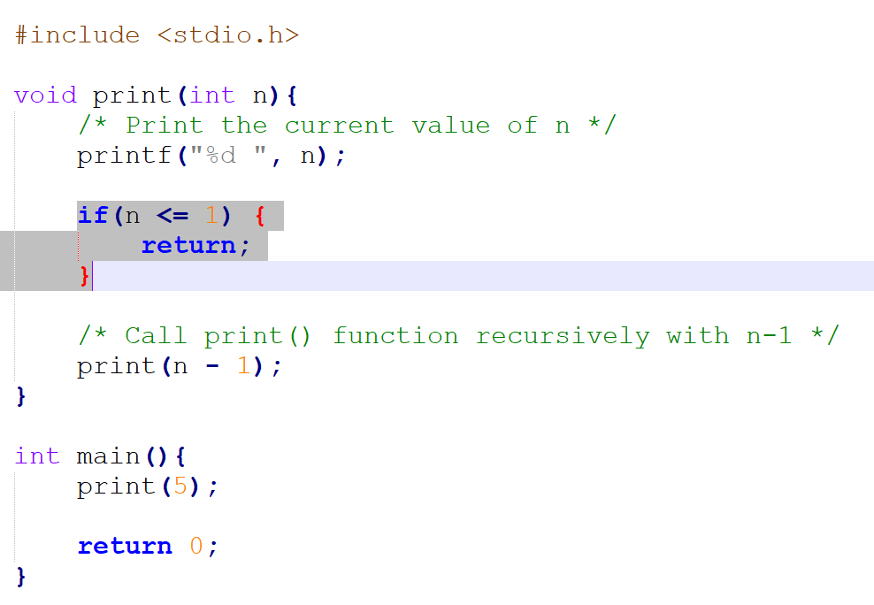
Example

Slide 24
Exercise
Write a C program to find cube of any number using function
Input any number: 5
Cube of 5 is: 125

Slide 25
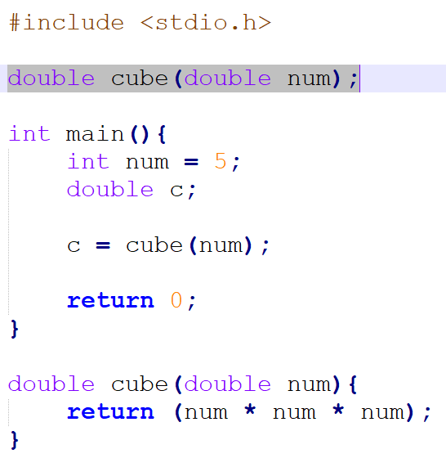
Answer
Function prototype decleration

Slide 26
Exercise
Find maximum and minimum among 3 numbers using function
Write a C program to check whether a number is prime
Write a C program to find all prime numbers between given interval

Slide 27
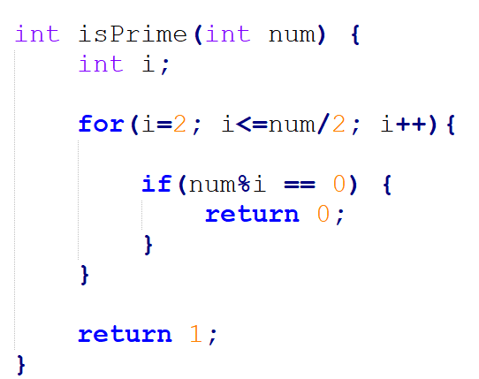
Answer

